Slide 1
CHAPTER 4 (PART II): PLAGIARISM
AP Ts. DR. LILY N

Slide 2

What is plagiarism?
Say No To Plagiarism
(And why you should care!)
Say No To Plagiarism

Slide 3

Did you Know?
The word plagiarism comes from the Latin plagiarius means "kidnapper"
It is intellectual theft
It is a serious scientific misconduct

Slide 4
plagiarism
Many people think of plagiarism as copying another's work or borrowing someone else's original ideas.
But terms like "copying" and "borrowing" can disguise the seriousness of the offense.
In other words, plagiarism is an act of fraud. It involves both stealing someone else's work and lying about it afterward.

Slide 5
plagiarism
According to the Merriam-Webster online dictionary, to "plagiarize" means:
to steal and pass off (the ideas or words of another) as one's own
to use (another's production) without crediting the source
to commit literary theft
to present as new and original an idea or product derived from an existing source
to use someone else’s ideas without attribution
to use someone else’s words without attribution
to cite the source incorrectly

Slide 6
plagiarism
All of the following are considered plagiarism:
turning in someone else's work as your own
copying words or ideas from someone else without giving credit
failing to put a quotation in quotation marks
giving incorrect information about the source of a quotation
changing words but copying the sentence structure of a source without giving credit
copying so many words or ideas from a source that it makes up the majority of your work, whether you give credit or not

Slide 7
plagiarism
Paradise Valley Community College's Definition of Plagiarism
Plagiarism includes, but is not limited to, the use of paraphrase or direct quotation of the published or unpublished work of another person without full and clear acknowledgment.
It also includes the unacknowledged use of materials prepared by another person or agency engaged in the selling of term papers or other academic materials.
Information gathered from the Internet and not properly identified is also considered plagiarism.
PVCC Student Handbook. 2012/2013. p. 136 Section 2.3.11 Academic Misconduct

Slide 8
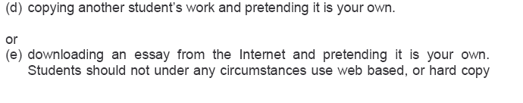
PLAGIARISM
2005-2006 MA/Diploma handbook, p.35-6.

Slide 9
plagiarism
Plagiarism is the presenting the words, ideas, images, sounds, or the creative expression of others as your own.
Using another’s exact words without proper citation

Slide 10
Plagiarism is plagiarism… irrespective of Intent, Source, Quantity and Copyright

Slide 11
Cyber-plagiarism?
Copying ideas, text, material from the web without proper accreditation
Digital plagiarism is a term used to describe copying using computers
Creativity is fine but plagiarism is faster…hmmm

Slide 12
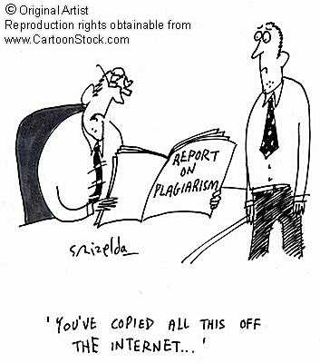
‘You’ve copied all this off the internet…’

Slide 13
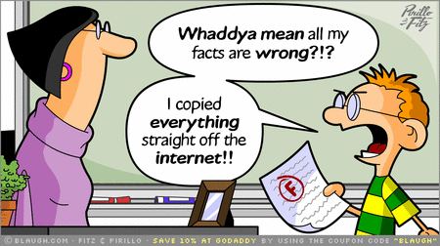

Slide 14
Images, audio, music, videos?
Using an image, video or piece of music in a work you have produced without receiving proper permission or providing appropriate citation is plagiarism.
The following activities are very common in today’s society. Despite their popularity, they still count as plagiarism.
Copying media (especially images) from other websites to paste them into your own papers or websites.
Making a video using footage from others’ videos or using copyrighted music as part of the soundtrack.
Performing another person’s copyrighted music (i.e., playing a cover).
Composing a piece of music that borrows heavily from another composition.

Slide 15
Why is plagiarism a bad thing?
Because it infringes academic ethics and academic norms
Because it is a form of theft and a type of fraud
Because plagiarists ultimately cheat themselves
Because plagiarists cheat their fellow friends
Because plagiarism reflects incompetence

Slide 16

What happens to plagiarists?
Image taken from: https://www.mstar.com.my/lokal/semasa/2017/12/27/hukum-gantung

Slide 17
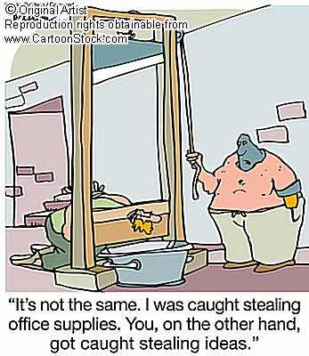
“It’s not the same. I was caught stealing office supplies. You on the other hand, got caught stealing ideas.”

Slide 18
What happens to plagiarists?
The consequences are not worth the risks!
Students who plagiarize or otherwise engage in academic dishonesty face serious consequences.
Sanctions may include, but are not limited to, failure on an assignment, grade reduction or course failure, suspension, and possibly dismissal.
Possible disciplinary action by the University
Many students are accused of plagiarism because they simply don't understand it and, therefore, don't know how to avoid it.
Cheating is unethical behavior

Slide 19
What happens to plagiarists?
In a survey of 24,000 students at 70 high schools, Donald McCabe (Rutgers University) found that:
64 percent of students admitted to cheating on a test,
58 percent admitted to plagiarism and
95 percent said they participated in some form of cheating, whether it was on a test, plagiarism or copying homework.

Slide 20
What happens to plagiarists?
“A study of 4,500 students at 25 schools:
72% admitted to serious cheating on written assignments using the Internet.”
Based on the research of Donald L. McCabe, Rutgers University
Source: “CIA Research.” Center for Academic Integrity, Duke University, 2003 <http://academicintegrity.org/cai_research.asp>.

Slide 21
What happens to plagiarists?
A survey of over 63,700 US undergraduate and 9,250 graduate students over the course of three years (2012-2015)--conducted by Donald McCabe, Rutgers University--revealed the following:
36% of undergraduates admit to “paraphrasing/copying few sentences from Internet source without footnoting it.”
24% of graduate students self report doing the same
38% admit to “paraphrasing/copying few sentences from written source without footnoting it.”
25% of graduate students self report doing the same
14% of students admit to “fabricating/falsifying a bibliography”
7% of graduate students self report doing the same
7% self report copying materials “almost word for word from a written source without citation.”
4% of graduate students self report doing the same
7% self report “turning in work done by another.”
3% of graduate students self report doing the same
3% report “obtaining paper from term paper mill.”
2% of graduate students report doing so

Slide 22

What happens to plagiarists?
Saturday, March 17, 2007 - R. A. Mashelkar resigns from patent panel following plagiarism charge
Dr. Mashelkar confirmed to The Hindu that certain lines used in their report's conclusion had been taken "verbatim" from a November 2005 paper that was authored by Shamnad Basheer, a doctoral student and an Associate at the Oxford Intellectual Property Research Centre, University of Oxford. (Feb 22, 2007)
Source: The Hindu

Slide 23
What happens to plagiarists?
MALAYSIA CASES:
An executive director of a private college of higher education affiliated with a UK university, and pop star Fazley Yaakob was found to hold two fake degrees, and two public company directors were also found to have fake degrees.
If a former MBA student of University of Bath had not done a Google search, he would not have discovered that University Technology Mara had illegally deposited in its library 14 academic theses done by students who graduated with MBA from Bath in 1994.
Plagiarism is not just confined to books. Australian Masterchef finalist Alvin Quah was accused of plagiarism by Rasa Malaysia’s Bee Yin Low from the Asian food blog Rasa Malaysia.

Slide 24
What happens to plagiarists?
MALAYSIA CASES:
Adeline Lee Zhia Ern, a Malaysian writer, was caught plagiarizing Jack Canfield’s Chicken Soup for the Soul IV in her first book Lethal Lesson and Other Stories, and her book was withdrawn from the market and destroyed.
An editor working for the New Straits Times, Brendan Pereira, was dismissed for plagiarizing the work of U.S. journalist Mitch Albom. Last year, the Malaysian national news agency Bernama suspended a journalist for plagiarizing an article from the Jakarta Post.
Back in 2013, an Utusan Malaysia writer Ridhuan Tee was accused of plagiarism by a Universiti Teknologi Malaysia lecturer Dr Aril Yasreen Mohd. Yassin. Although the matter was never resolved, Ridhuan Tee was appointed an associate professor at Universiti Pertahanan Nasional Malaysia (National Defence University).

Slide 25
What happens to plagiarists?
MALAYSIA CASES:
The study went on to state that 95.7% of students had partaken in some form of plagiarism, 96% had shared an assignment with other students, 93% had cheated during tests, 92% had falsified data, 86% had cheated in exams, and 90% had copied a friends assignment.
Two Universiti Putra Malaysia (UPM) lecturers who were caught plagiarizing materials from the internet to produce an effective writing handbook. The action taken against the authors was only a reprimand.
A similar case involving a Dean from one of the faculty in UMK was ‘pushed under the rug’. The issue on plagiarism is successfully justified that the Plaintiff’s PHD Thesis was copied exactly from the writing of Viola Shafiq from the book of “Arab Cinema”. However the IEEE banned any papers from the academic in any of their journals for 10 years.

Slide 26
What happens to plagiarists?
Most cases of plagiarism can be avoided, however, by citing sources.
Simply acknowledging that certain material has been borrowed and providing your audience with the information necessary to find that source is usually enough to prevent plagiarism.
BUT STILL…

Slide 27
WHY DO PEOPLE PLAGIARIZE?
Ignorance
Lack of knowledge on the ethics of scholarly writing / poor writing skills
Ambition, fierce competition
Pressure from seniors
Publish or perish system
Faster and easy
Chances of getting caught or action being taken is slim
The pressure of workload
Pressure to succeed

Slide 28
WHY DO PEOPLE PLAGIARIZE?
It’s okay if
I don’t get caught!
Everyone does it!
I was too busy to
write that paper!
(Job, big game, too much homework!)
This assignment
was BORING!
I’ve got to get
into a
certain college.!
My teachers
expect
too much!
My parents
expect “A”s!

Slide 29

A Plagiarist is:
Too careless
Too lazy
Too dishonest
By Cindy Nottage

Slide 30

Preventing plagiarism
Quote and cite phrases, sentences, and paragraphs taken directly from the original source.
Quote and cite statistics, charts, graphs and drawings taken directly from the original source.
When you paraphrase or summarize, give credit to the original author.

Slide 31
Do I have
to cite
everything?

Slide 32
Answer: YES!!
Except –
When you use your own words
When the fact used is common knowledge.
What makes it “common knowledge”?
If you can find the same information in at least 3 different sources, you don’t have to cite it.
Ex. George Washington wore wooden dentures.

Slide 33
What’s the big deal?
Wrong! Paraphrasing
original ideas without
documenting
your source,
is plagiarism too!
If I change a
few words, I’m still okay,
right?

Slide 34
Avoiding plagiarism
For short quotes, use quotation marks in the sentence.
For longer quotes indent the entire passage
If you have used a table, chart, diagram etc., cite the source directly below with a statement that permission has been obtained.
“All sources should be disclosed and, if large amounts of other people's written or illustrative material are to be used, permission must be sought.” COPE, 1999.
Even if you change a few words here and there it is considered plagiarism

Slide 35
Use these three strategies
Quoting
Paraphrasing
Summarizing
To blend source materials in with your own, making sure your own voice is heard.

Slide 36
Quoting
Quotations are the exact words of an author, copied directly from a source, word for word. Quotations must be cited!
Carol Rohrbach and Joyce Valenza

Slide 37
When quoting directly
Keep the person’s name near the quote in your notes, and in your paper
Select those direct quotes that make the most impact in your paper -- too many direct quotes may lessen your credibility and interfere with your style
Mention the person’s name either at the beginning of the quote, in the middle, or at the end
Put quotation marks around the text that you are quoting
Indicate added phrases in brackets ([ ]) and omitted text with ellipses (. . .)
Ensure you note exact page numbers in the reference
Source: http://owl.english.purdue.edu/handouts/research/r_plagiar.html

Slide 38
When quoting indirectly
Keep the person’s name near the text in your notes, and in your paper
Rewrite the key ideas using different words and sentence structures than the original text
Mention the person’s name either at the beginning of the information, or in the middle, or at that end
Double check to make sure that your words and sentence structures are different than the original text
Ensure you note exact page numbers in the reference
Source: http://owl.english.purdue.edu/handouts/research/r_plagiar.html

Slide 39
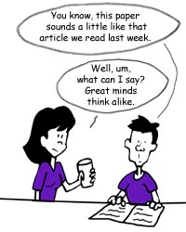
WHEN Paraphrasing
Paraphrasing means putting someone else’s words or ideas into your own words.
Although you are using your own words, the ideas are taken from someone else and must be cited on your Works-Cited page.

Slide 40
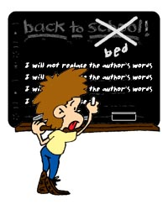
Paraphrasing
Paraphrasing is not simply rearranging or rewording an original passage.
You have to understand what the author is saying and write the ideas entirely in your own words.

Slide 41

Paraphrasing
Give the author credit when you quote or paraphrase.
Eg:
“According to Jim Carty, the CATS are ranked fourth in backcourts this year with Rondo, Sparks, Crawford, Bradley, and Moss.”

Slide 42
Paraphrasing
Paraphrasing is the act of rephrasing a text in your own words.
Paraphrasing is the most common type of plagiarism.
Paraphrasing itself is not plagiarism so long as you properly cite your sources.
However, paraphrasing becomes plagiarism when you read different sources, pull out the key points and then rewrite these points as if they were your own ideas.

Slide 43
Citing paraphrasing
Paraphrased material must be cited. Even though paraphrasing means that you are restating information in your own words, you must give credit to the original source of the information.
Citations for paraphrased material should always include both the author and the year. In-text citation can be placed within the sentence or at the end:
Example: According to Johnson (2012), mirror neurons may be connected with empathy and imitation.
Example: Mirror neurons may be connected with empathy and imitation in human beings (Johnson, 2012).

Slide 44
Paraphrasing
Given:
Because the intracellular concentration of potassium ions is relatively high, potassium ions tend to diffuse out of the cell. This movement is driven by the concentration gradient for potassium ions. Similarly, the concentration gradient for sodium ions tends to promote their movement into the cell. However, the cell membrane is significantly more permeable to potassium ions than to sodium ions. As a result, potassium ions diffuse out of the cell faster than sodium ions enter the cytoplasm. The cell therefore experiences a net loss of positive charges, and as a result the interior of the cell membrane contains an excess of negative charges, primarily from negatively charged proteins.¹ (p. 204).

Slide 45
Paraphrasing
Here is an Appropriate Paraphrase of the above material:
A textbook of anatomy and physiology¹ reports that the concentration of potassium ions inside of the cell is relatively high and, consequently, some potassium tends to escape out of the cell. Just the opposite occurs with sodium ions. Their concentration outside of the cell causes sodium ions to cross the membrane into the cell, but they do so at a slower rate. According to these authors, this is because the permeability of the cell membrane is such that it favors the movement of potassium relative to sodium ions. Because the rate of crossing for potassium ions that exit the cell is higher than that for sodium ions that enter the cell, the inside portion of the cell is left with an overload of negatively charged particles, namely, proteins that contain a negative charge.

Slide 46
Paraphrasing
Here is an Inappropriate Paraphrase of the above material:
Because the intracellular concentration of potassium ions is high, potassium ions tend to diffuse out of the cell. This movement is triggered by the concentration gradient for potassium ions. Similarly, the concentration gradient for sodium ions tends to promote their movement into the cell. However, the cell membrane is much more permeable to potassium ions than to it is to sodium ions. As a result, potassium ions diffuse out of the cell more rapidly than sodium ions enter the cytoplasm. The cell therefore experiences a _ loss of positive charges, and as a result the interior of the cell membrane contains a surplus of negative charges, primarily from negatively charged proteins.¹ (p. 204).

Slide 47
When paraphrasing and summarizing
Action during the writing process
First, write your paraphrase and summary without looking at the original text, so you rely only on your memory.
Next, check your version with the original for content, accuracy, and mistakenly borrowed phrases
Appearance on the finished product
Begin your summary with a statement giving credit to the source: According to Jonathan Kozol, ...
Put any unique words or phrases that you cannot change, or do not want to change, in quotation marks: ... "savage inequalities" exist throughout our educational system (Kozol 1992: 1).
Ensure you note exact page numbers in the reference
Source: http://owl.english.purdue.edu/handouts/research/r_plagiar.html

Slide 48
Effective Paraphrasing
Choose which of these are the 6 Best Steps to Effective Paraphrasing:
Read over the text several times until you grasp its full meaning.
Quoting whenever possible because paraphrasing is not credible.
Set the original text aside, and write your paraphrase on a note card or sheet of paper.
On the note card, jot down the subject of the paraphrase and a few key words that will help you put this information in context later on in your paper.
Cut and paste the information you want in your paper without citing it until you are done.

Slide 49
Effective Paraphrasing
6. Go back and check your notes to make sure you included all the necessary information
that was in the original material.
7. Use quotation marks to identify unique words or terminology that you borrowed directly
from the original material.
8. Do not waste your time understanding the text, just use its ideas however you would like.
9. Record the bibliographic information on the note card so you can easily refer to it if you use the material in your paper.
Answer: ? ? ? ? ? ?
Notes:
1,3,4,6,7,9

Slide 50
As you take notes:
Include page numbers and source references so you can go back and check for accuracy as you write.

Slide 51
As you take notes:
Action during the writing process
Mark everything that is someone else’s words with a big Q (for quote) or with big quotation marks
Indicate in your notes which ideas are taken from sources (S) and which are your own insights (ME)
Record all of the relevant documentation information in your notes
Ensure you note exact page numbers in the reference
Source: http://owl.english.purdue.edu/handouts/research/r_plagiar.html

Slide 52
DON’T
Cut and paste from any source
Use another student’s work as your own
Just change a few words from any source for your paper
Turn in a paper you wrote for another class

Slide 53
You can prevent plagiarism (stealing words and ideas)
All you need to do is:
Take notes—put in your own words.
If you do copy words, put “ ” around them and footnote whose words they are.
Keep track of EVERY resource you use!
Cite all of your sources at the end of your work.

Slide 54
types of plagiarism:
Intentional
Copying a friend’s work
Buying or borrowing papers
Cutting and pasting blocks of text from electronic sources without documenting
Media “borrowing” without documentation
Unintentional
Careless paraphrasing
Poor documentation
Failure to use your own “voice”

Slide 55
Unintentional Plagiarism
Paraphrasing poorly: changing a few words without changing the sentence structure of the original, or changing the sentence structure but not the words.
Quoting poorly: putting quotation marks around part of a quotation but not around all of it, or putting quotation marks around a passage that is partly paraphrased and partly quoted.
Citing poorly: omitting an occasional citation or citing inaccurately.
MLA handbook for writers of research papers. (7th ed.). The Modern Language Association of America. New York: 2009. Print.

Slide 56
Intentional Plagiarism
Passing off as one’s own pre-written papers from the Internet or other sources.
Copying an essay or article from the Internet, on-line source, or electronic database without quoting or giving credit.
Cutting and pasting from more than one source to create a paper without quoting or giving credit.
Borrowing words or ideas from other students or sources without giving credit.
MLA handbook for writers of research papers. (7th ed.). The Modern Language Association of America. New York: 2009. Print.

Slide 57
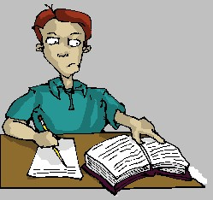
Types of plagiarism
Word for word (Direct, Text)
Mosaic / Structure
Thesaurus (Paraphrase)
Ideas
Authorship
Secondary sources
Self plagiarism

Slide 58
Types of plagiarism
Plagiarism of Words
The use of another’s exact words without citing the author
Incorrect
Plagiarism is the reproduction of someone else’s words, ideas or findings and presenting them as one’s own without proper acknowledgement.
Correct
Plagiarism is the “reproduction of someone else’s words, ideas or findings and presenting them as one’s own without proper acknowledgement” (Undergraduate Course Handbook: 2008, p.24)

Slide 59
Types of plagiarism
Plagiarism of Structure
Paraphrasing another’s words by changing sentence construction or word choice with citation
Paraphrasing while maintaining original sentence construction with acknowledging the source

Slide 60
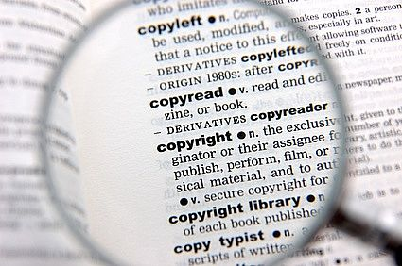
Types of plagiarism
Plagiarism of Ideas
Presenting another’ sideas as your own without giving the person credit
Submitting a paper without citing or incorrectly citing another’s ideas

Slide 61
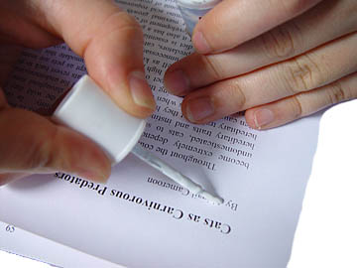
Types of plagiarism
Plagiarism of Authorship
Turning in a replication of another’s work
Submitting a paper that you got off the internet or from a friend and presenting it as your own

Slide 62

TypeS of plagiarism
Plagiarism of Self
The use of previous work for a separate assignment
Although these were you original words and thoughts, receiving credit for a previous assignment is considered cheating

Slide 63
self-plagiarism
The practice of an author using portions of their previous writings on the same topic in another of their publications, without specifically citing it formally in quotes.
This practice is widespread and at times unintentional
Violates the copyright that has been assigned to the publisher
No consensus whether this is scientific misconduct

Slide 64
Fair use of intellectual property
use of a copyrighted work for purposes such as criticism, comment, news reporting, teaching or scholarship.
use copyrighted materials without seeking permission from the creator or publisher and without paying copyright fees.
Does not mean that you can plagiarize!!!

Slide 65
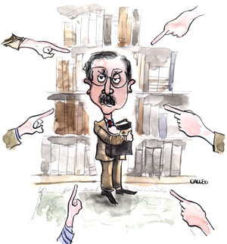

Copyright and plagiarism
12,500 USD
Plagiarism issues are not strictly related to copyright issues - though the two may overlap.
Copyright is a legal concept; plagiarism is literary and more of an ethical issue.
Publishers are more worried about copyright violation.
WAME discussion board

Slide 66
10 types of plagiarism
The Plagiarism Spectrum identifies 10 types of plagiarism based on findings from a worldwide survey of nearly 900 secondary and higher education instructors.
© Turnitin 2016. All stats: Turnitin White Paper The Plagiarism Spectrum: Instructor Insights into the 10 Types of Plagiarism.

Slide 67
Citing Sources
BibMe
Citation Maker
Citation Machine
KnightCite
.

Slide 68
PLAGIARISM CHECKER
PLAGIARISM CHECKER
Quetext
BibMe
Plagramme
Paper Rater
TurnitIn

Slide 69
WHICH OF THE FOLLOWING FIVE CASES IS/ARE PLAGIARISM?

Slide 70
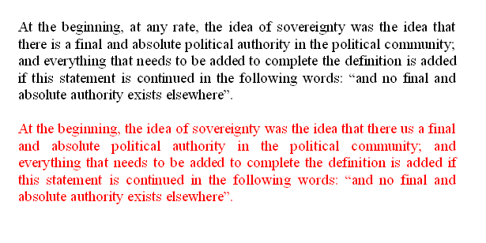
1

Slide 71
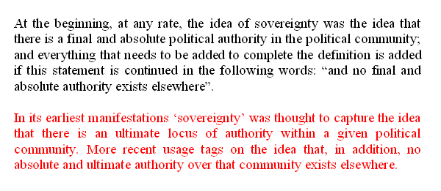
2

Slide 72
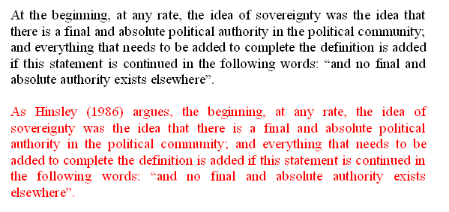
3

Slide 73
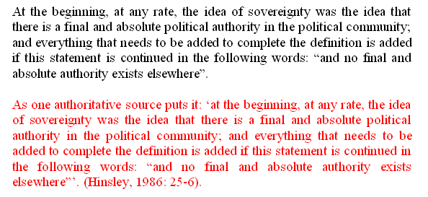
4

Slide 74
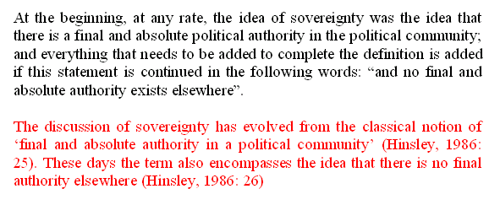
5

Slide 75
references and citation
“Boston Columnist Resigns Amid New Plagiarism Charges.” CNN.com 19 Aug. 1998 3 March 2003 <http://www.cnn.com/US/9808/19/barnicle/>
Fain, Margaret. “Internet Paper Mills.” Kimbal Library. 12 Feb. 2003. <http://www.coastal.edu/library/mills2.htm>
Lathrop, Ann and Kathleen Foss. Student Cheating and Plagiarism in the Internet Era. Englewood, CO: Libraries Unlimited, 2000.
Lewis, Mark. “Doris Kearns Goodwin And The Credibility Gap.” Forbes.com 2 Feb. 2002. <http://www.forbes.com/2002/02/27/0227goodwin.html>
“New York Times Exposes Fraud of own Reporter.” ABC News Online. 12 May, 2003.
<http://www.pbs.org/newshour/newshour_index.html>
Sabato, Larry J. “Joseph Biden's Plagiarism; Michael Dukakis's 'Attack Video' – 1988.” Washington Post Online. 1998. 3 March 2002. <http://www.washingtonpost.com/wpsrv/politics/special/clinton/frenzy/biden.htm>

Slide 76
references and citation
http://owl.english.purdue.edu/handouts/research/r_plagiar.html
http://www.virtualsalt.com/antiplag.htm
http://www.psa.ac.uk/psanews/0403/plagiarism.htm
http://www.hamilton.edu/academics/resource/wc/usingsources.html?CFID=1415438&CFTOKEN=46586906
www.centralia.edu/academics/writingcenter/
http://owl.waol.org/
https://www.scribbr.com/plagiarism/types-of-plagiarism/

